Slide 1


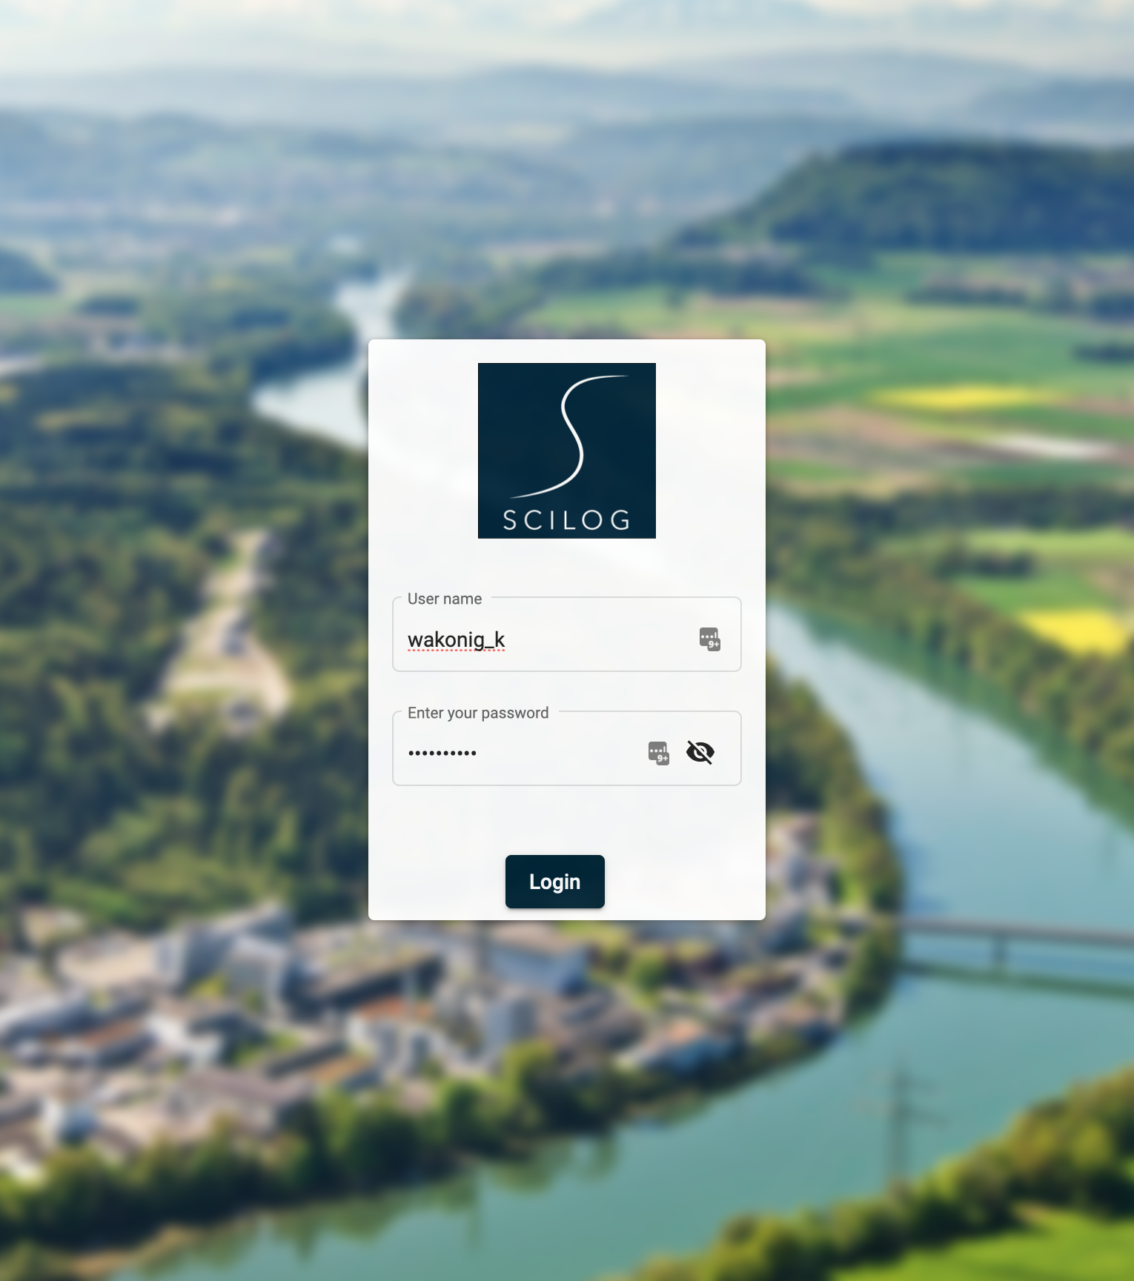
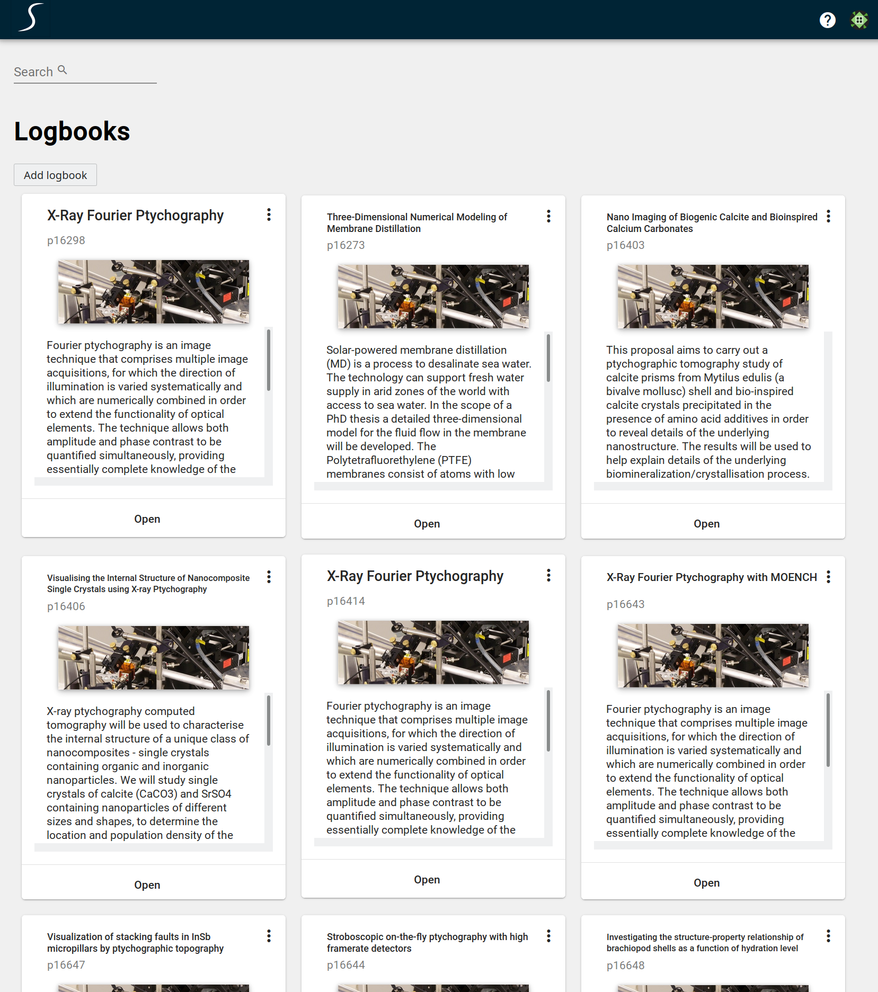
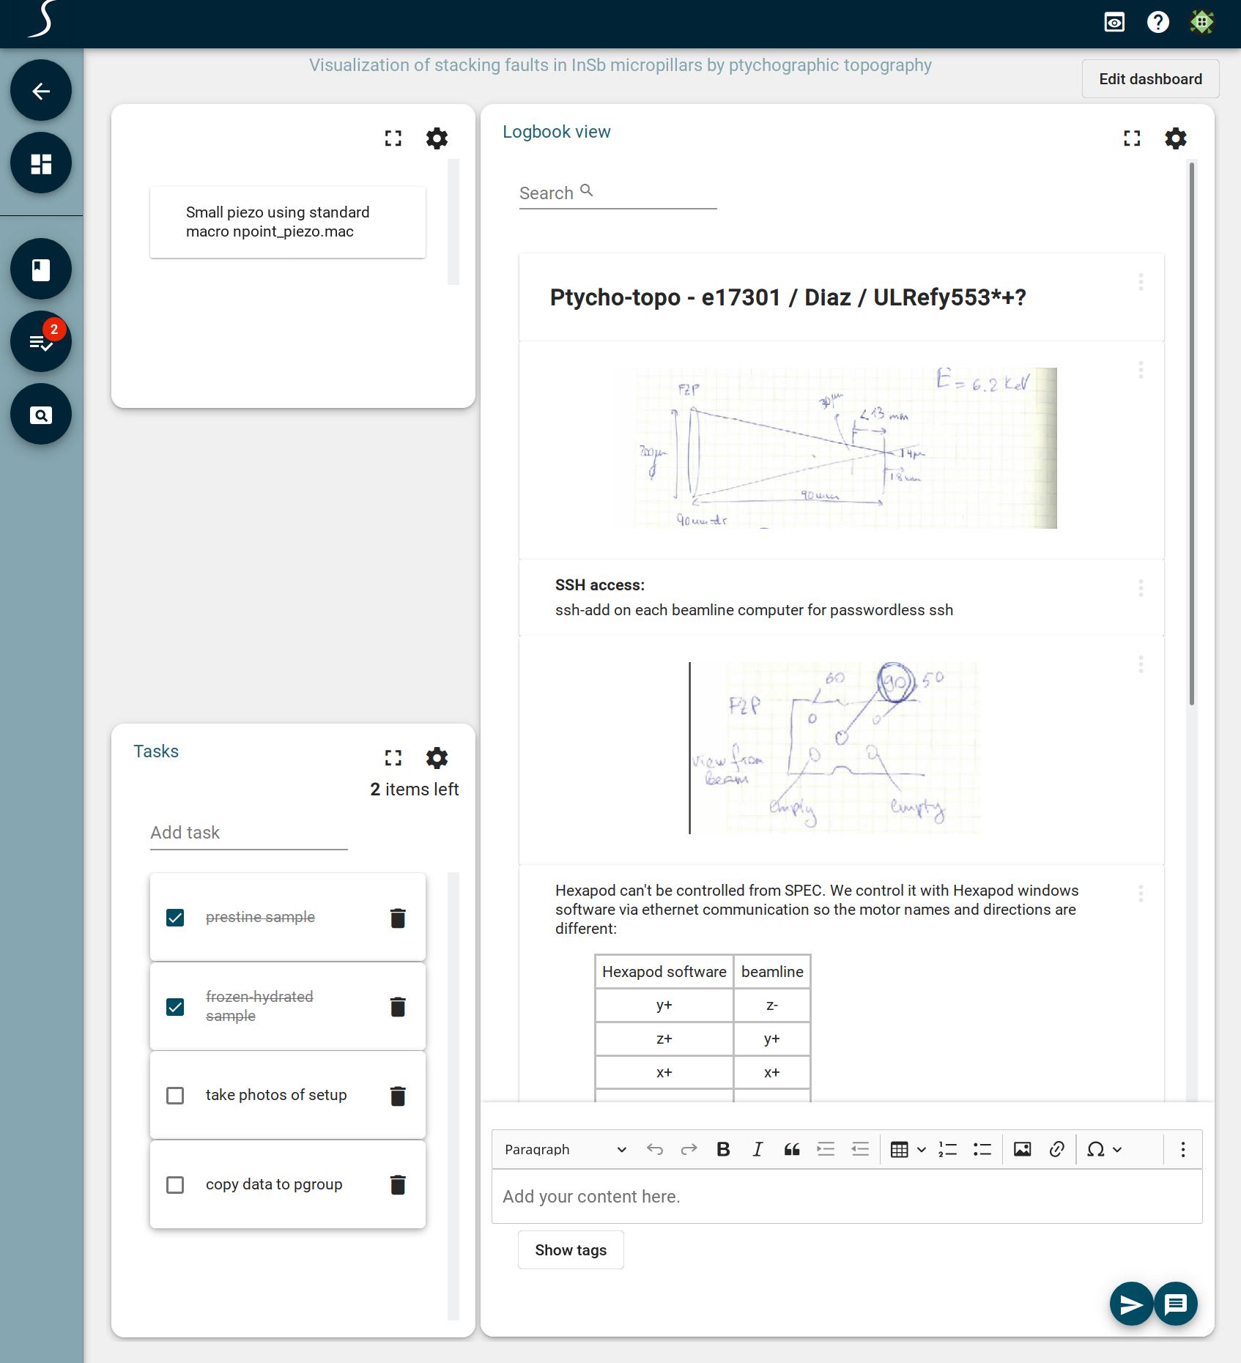
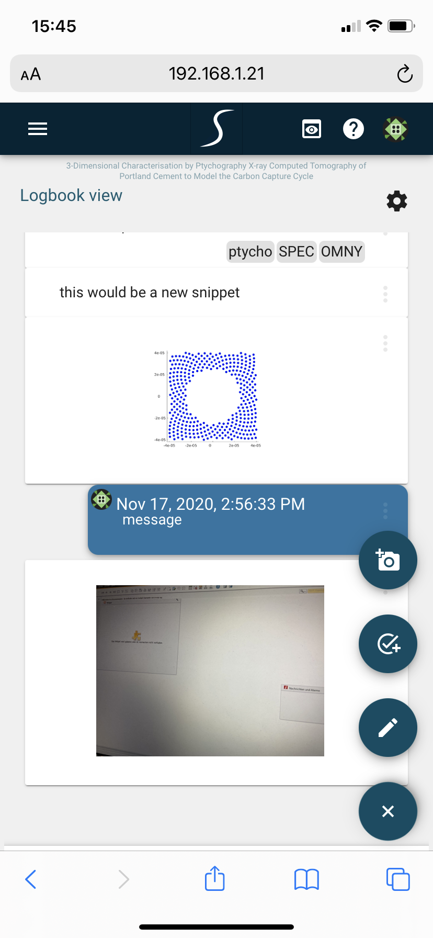
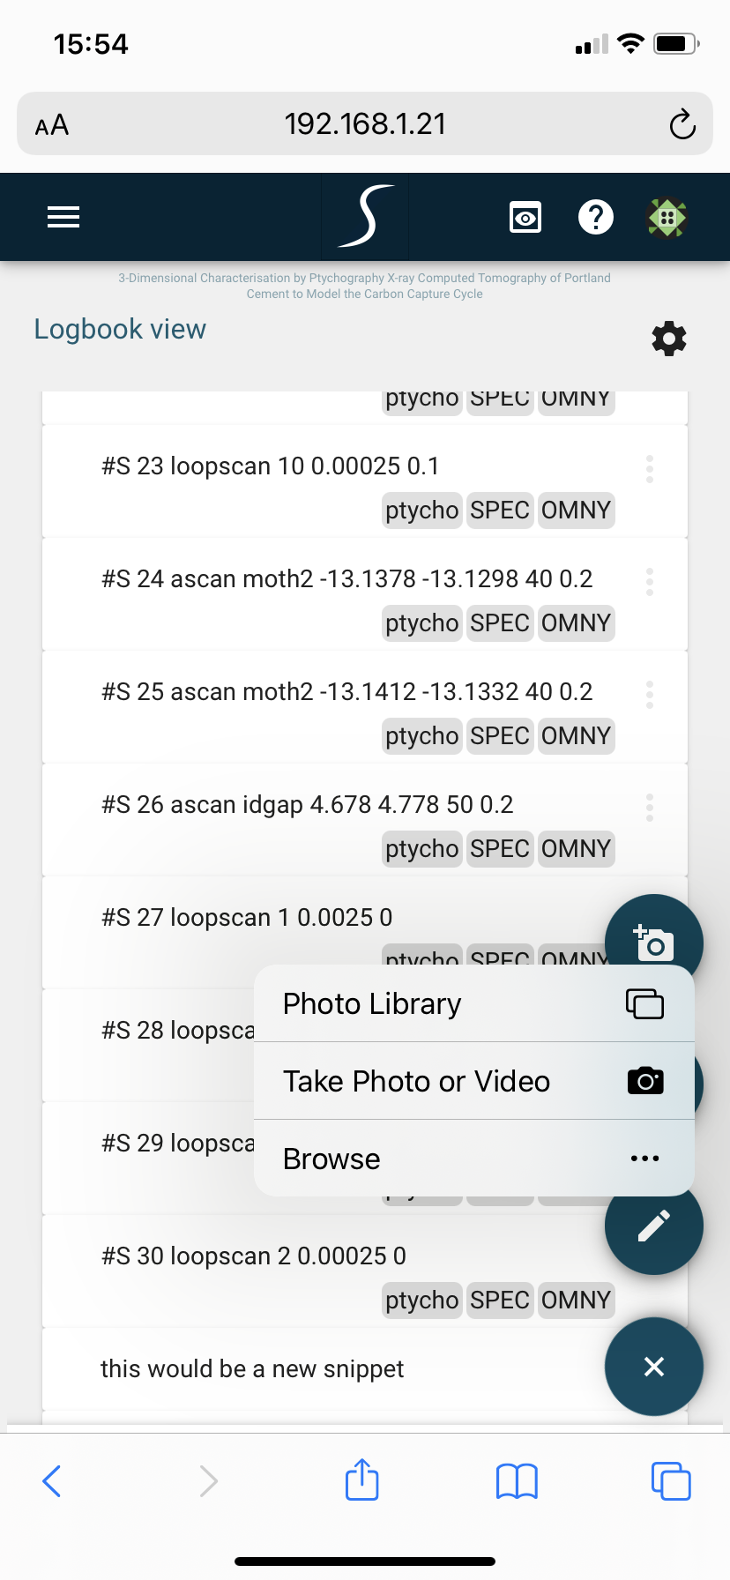
SciLog
An Electronic Logbook for User Experiments
S. Egli, C. Minotti, K. Wakonig
Paul Scherrer Institut, 5232 Villigen PSI, Switzerland
Properly capturing raw and meta-data during an experiment is rightfully given a high priority. Yet, it is the logbook that aids in putting the decisions made during the experiment and thus also the acquisition strategy itself into context. However, logbooks are frequently lacking a good integration into facility-specific services such as authentication and data acquisition systems and often end up as a burden, especially in stressful situations during an experiment.
SciLog, a logbook system based on MongoDB, Loopback and Angular, aims to alleviate these constrains by providing a flexible and extensible environment as well as a simple and intuitive user interface.
Users can login using their PSI account, experiment account (“eaccount”) or a functional account. This allows for a flexible user authorization without the need of creating new accounts for users.
The automatic creation of logbooks based on proposal information enables users to immediately capture their thoughts and decisions without any setup required.
Additional logbooks can be created through the web interface or the Python SDK if needed.
After opening a logbook, the user is presented with a dashboard that can be customized to the user’s needs for a particular experiment.
Entries in the logbook are stored in a MongoDB and can be queried and filtered freely. In addition, the usage of tags enable users can search and filter more efficiently.
Furthermore, the modular dashboard can be used to add widgets to plot, pin entries or add task lists.
Although data can be ingested automatically through a Python SDK, it is sometimes necessary to capture photos of e.g. an experiment setup. While in the past, this had to be transferred to a computer first, the optimized interface for mobile devices enables users to capture, upload and share their photos with a click of a button.
SciLog is currently being tested internally and will soon be accessible also outside of the PSI network. For more information, please contact stephan.egli@psi.ch

